Slide 1

Identify root components of website below

Slide 2
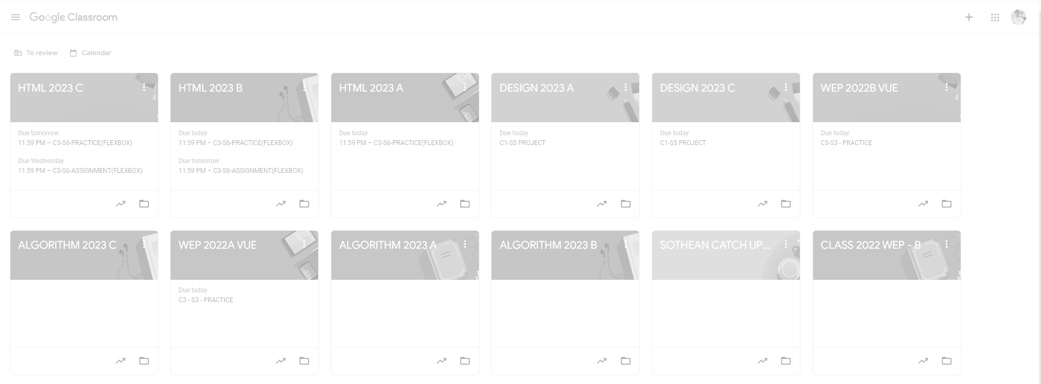
Root div
- Height: 100vh
content
nav
Flex: 0
header
Flex: 0
Flex: 1

Slide 3
1. Page-Level Layout(Top-Level Containers)
.app-container
+ Role: Root Wrapper for the entire application
+ Flex Direction (Column)
+ Direction Children (.header-nav, main character)
.nav-left
Nav header
Right header

Slide 4
.nav-left
.nav-center
.nav-right

Slide 5

.body-layout
.banner-container
.main-container

Slide 6
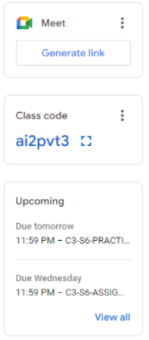
.card-header
.card-action
.cadr-header
.code-content
.upcoming-header
.upcomming-items
.upcomming-footer

Slide 7


